Slide 1
Employee Data Analysis using Excel
STUDENT NAME:DEVAYANI M
REGISTER NO:3D12B0676B24B1EA11141C270D750EA7,312208659
DEPARTMENT:B.COM(GENERAL)
COLLEGE:MEENAKSHI COLLEGE FOR WOMEN

Slide 2
PROJECT TITLE
Employee Performance Analysis using Excel

Slide 3


AGENDA
Problem Statement
Project Overview
End Users
Our Solution and Proposition
Dataset Description
Modelling Approach
Results and Discussion
Conclusion
3/21/2024 Annual Review

Slide 4

PROBLEM STATEMENT
Employee performance analysis using Excel can help you to track.
Evaluate individual performance, identify areas for improvement, and make data driven decision.
Employee performance analysis system in Excel to support informed decision making and drive business success.

Slide 5

PROJECT OVERVIEW
This project provides a structured approach to creating an employee performance analysis dashboard in Excel, helping you to effectively track, analyze, and present performance data
.

Slide 6

WHO ARE THE END USERS?
1.HR Manager
2.Supervisors and Team leads
3.Department Heads
4.Operation managers
5.Business Analysts
6.Business owners and Executives
7.Employee development
specialists

Slide 7

OUR SOLUTION AND ITS VALUE PROPOSITION
FILTERING- REMOVE VALUES
PIVOT TABLE- SUMMARY OF EMPLOYEE PERFORMANCE
CHART LINE – FINAL REPORT

Slide 8
Dataset Description
EMPLOYEE DATA SET- NAN MUDHALVAN PORTAL
9 FEATURES IN EXCEL :
EMPLOYEE ID- ALPHANUMERIC(TEXT)
NAME - ALPHABETICAL(TEXT)
GENDER-ALPHABETICAL(TEXT)
DEPARTMENT-ALPHABETICAL(TEXT)
SALARY-NUMERICAL
START DATE-ALPHANUMERIC(TEXT)
FTE-NUMERICAL
EMPLOYEE TYPE-ALPHABETICAL(TEXT)
EMPLOYEE LOCATION-ALPHABETICAL(TEXT)
3 FEATURES USED:
DEPARTMENT -ALPHANUMERIC(TEXT)
FTE-NUMERICAL
EMPLOYEE TYPE-ALPHABETICAL(TEXT)

Slide 9

THE "WOW" IN OUR SOLUTION
Automate data collection and updates using Excel’s power query and macros.
Real-time performance tracking and alerts for timely intervension.
Regular updates and refreshes to ensure data accuracy and relevance.
3/21/2024 Annual Review
9

Slide 10
MODELLING
STEP-1
DOWNLOAD THE EMPLOYEE DATASET AND OPEN THE EMPLOYEE DATASET IN EXCEL.
STEP-2
SELECT THE ENTIRE DATA AND CLICK ON DATA AND CLICK ON FILTER OPTION.
STEP-3
FILTER FTP FROM A TO Z ORDER.
STEP-4
SELECT THE ENTIRE DATA QAND CLICK ON INSERT AND CLICK ON PIVOT TABLE TO CREATE PIVOT TABLE
STEP-5
DRAG THE NEEDED DATA AND CREATE A PIVOT TABLE
STEP-6
SLECT THE PIVOT TABLE AND CLICK ON INSERT
STEP-7
NOW CLICK ON THE CHART THAT YOU WANT
STEP-8
THE CHART IS CREATED
10

Slide 11
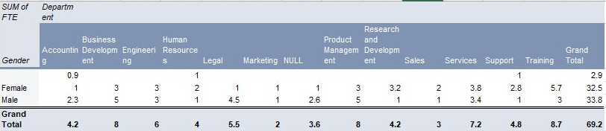
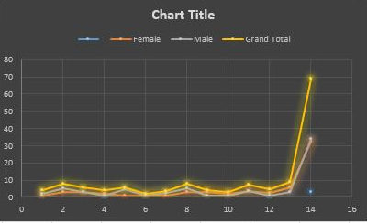
RESULTS
11

Slide 12
conclusion
Excels capabilities , such as Automation, visualization, and analysis, make it an ideal tool for employee performance management . By leveraging Excel, organization can create a streamlined, accurate, and informative performance Analysis system that benefit both employees and the company.

